Slide 1
Lecture 8
Working with files

Slide 2
Need for a data file
To Store data in organized manner
To store data permanently
To access data faster
To Search data faster
To easily modify data later on

Slide 3
File Handling
File handling in Python enables us to create, update, read, and delete the files stored on the file system through our python program.
In Python, File Handling consists of following three steps:
  Open the file.
  Process file i.e perform read or write operation.
  Close the file.

Slide 4
Opening a file and File object function: open()
Before any reading or writing operation of any file, it must be opened first.
A file can be opened with a built-in function called open(). This function takes in the file’s address and the access_mode and returns a file object.
A file object allows us to use, access and manipulate all the user accessible files.
Syntax: file_object = open(file_name, access_mode)
  File_name is the full name of the file with its path written between quates
  Access_mode determines what kind of operations can be performed with file,like read,write etc.
Note : for text file operation file extension should be .txt

Slide 5
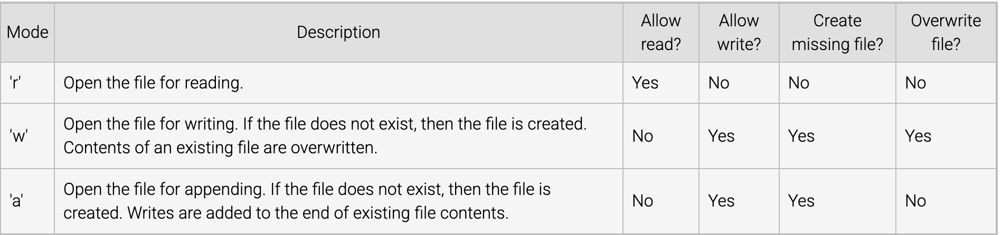
File access modes
A mode indicates how a file is opened, such as whether or not writing to the file is allowed, if existing contents of the file are overwritten or appended, etc.
There are different types of access_modes:

Slide 6
Read/write text file
The read() Method
  It reads the entire file and returns it contents in the form of a string.
  Reads at most size bytes or less if end of file occurs. if size not mentioned then read the entire file contents
The write() Method
  It writes the contents to the file in the form of string.
  It does not return value. Due to buffering, the string may not actually show up in the file until the flush() or close() method is called.

Slide 7
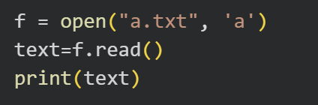
Reading file function: read([size])
read() function reads the entire file and returns it contents in the form of a string.
Reads at most size bytes from the file (less if the read hits EOF before obtaining size bytes).
If the size argument is negative or omitted, read all data until EOF is reached.

Slide 8
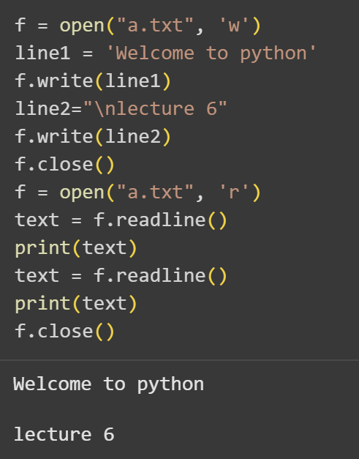
Reading a line from the file function: readline(size)
readline() function reads the first line of the file i.e till a newline character or an EOF in case of a file having a single line and returns a string.
If the size argument is present and non-negative, it is a maximum byte count (including the trailing newline) and an incomplete line may be returned.
An empty string is returned only when EOF is encountered immediately.

Slide 9
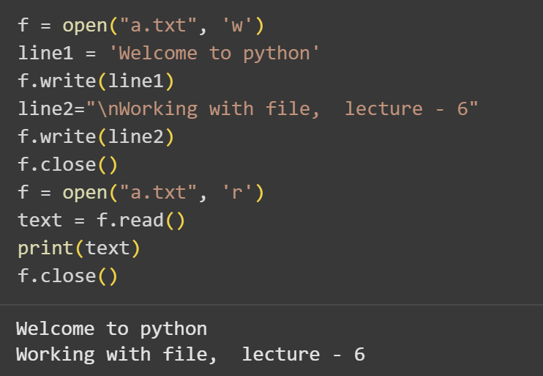
Writing to a file function: write(“string”)
write(“string”) function writes the contents of string to the file.
It has no return value.
Due to buffering, the string may not actually show up in the file until the flush() or close() method is called.

Slide 10
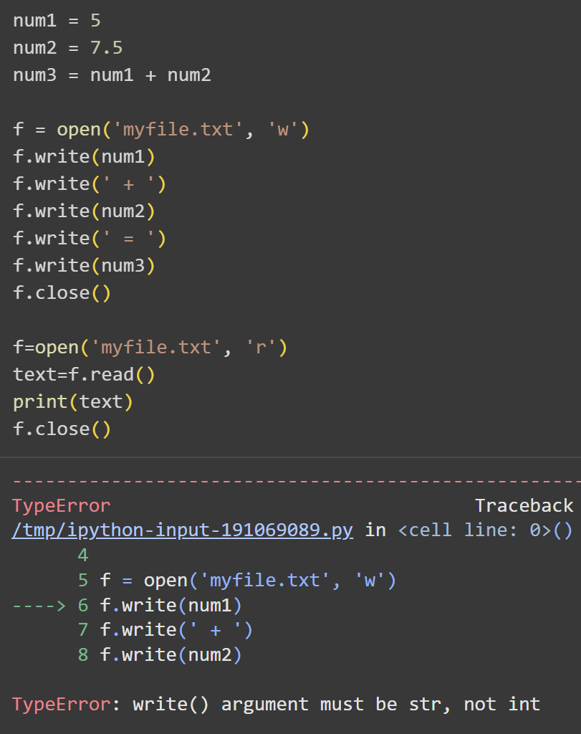
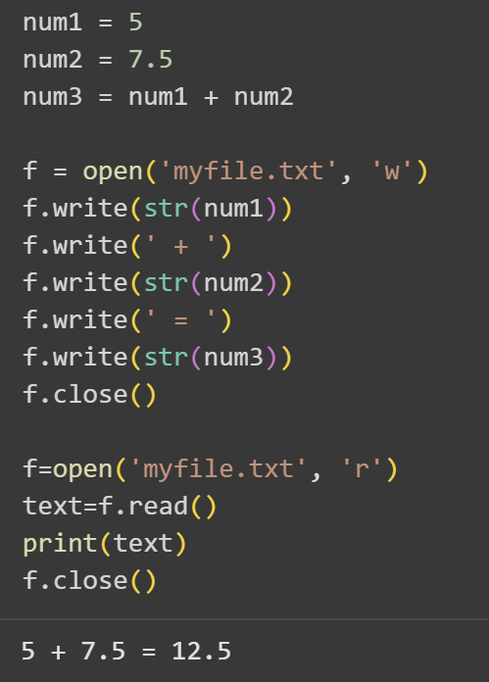
Writing to a file
function: write(“string”)
Numeric values must be converted to strings to be able to write it into a file

Slide 11
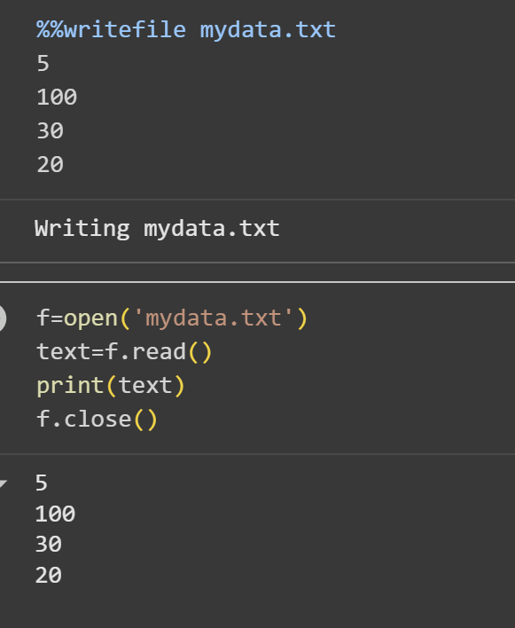
%%writefile
The %%writefile magic command is specific to Jupyter Notebook and IPython environments. It allows you to write the contents of a cell directly to a file. However, this command does not work in a regular Python script or interactive Python shell.
Syntax: %%writefile filename.txt

Slide 12
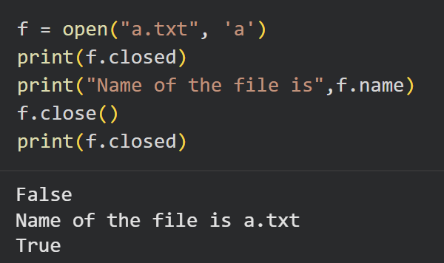
Closing a file function: close()
close() function is used to close an open file.
After using this method, an opened file will be closed and a closed file cannot be read or written any more.

Slide 13
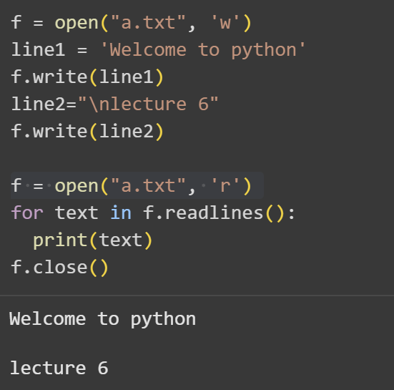
Iterating over lines in a file
Example:
Output:

Slide 14
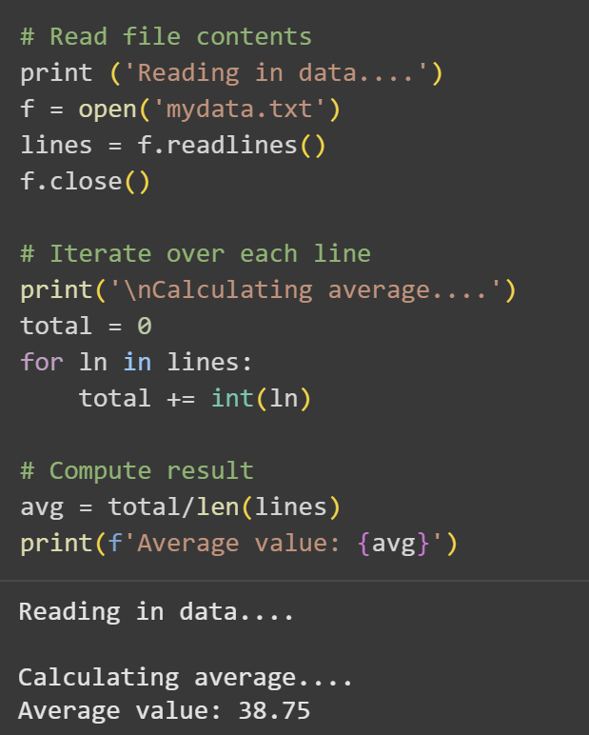
Example: iterating and calculating average

Slide 15
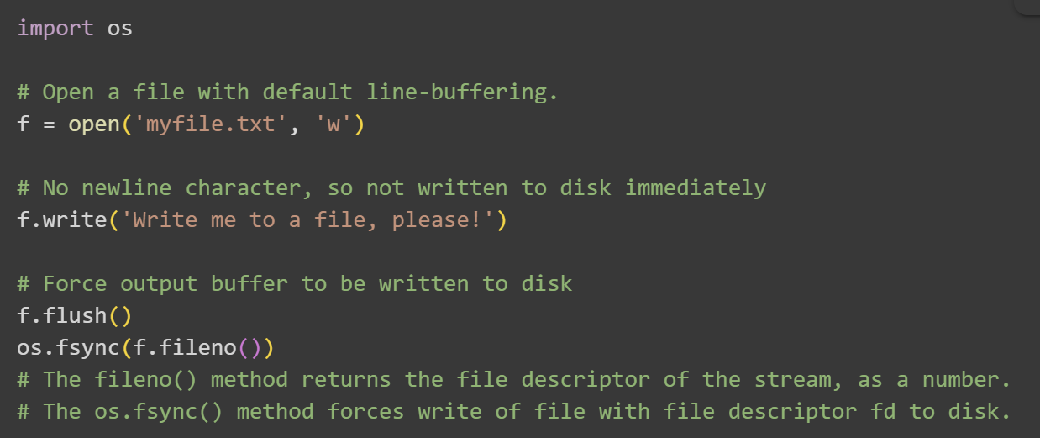
flush() method
It is a file method can be called to force the interpreter to flush the output buffer to disk.

Slide 16
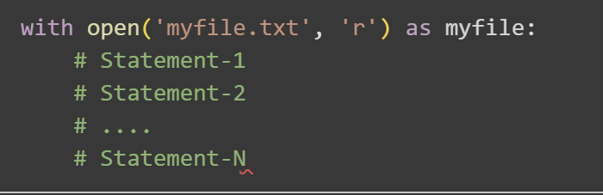
The 'with' statement
A with statement can be used to open a file, execute a block of statements, and automatically close the file when complete.
The with statement creates a context manager, which manages the use of a resource, such as a file, by performing set-up and teardown operations.

Slide 17
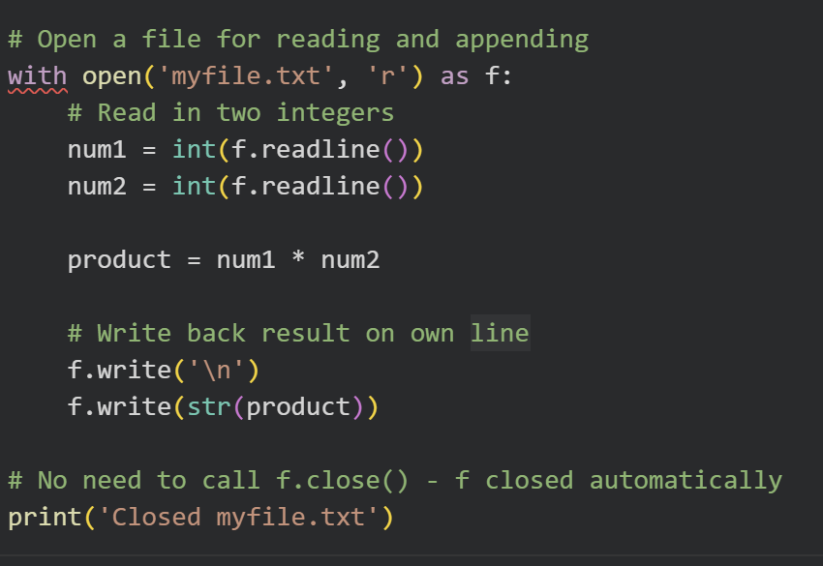
Example

Slide 18
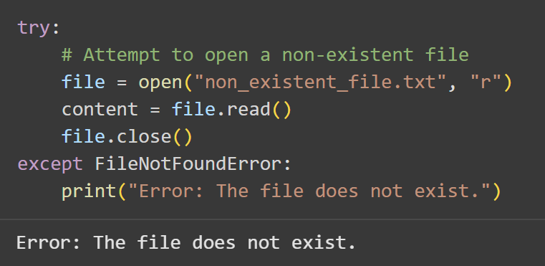
Handling File Not Found Error
If a file does not exist, trying to open it in read mode causes a FileNotFoundError. We can handle this using try-except
  The try block attempts to open non_existent_file.txt in read mode.
  Since the file does not exist, a FileNotFoundError is raised.
  The except block catches this error and prints a user-friendly message.

Slide 19
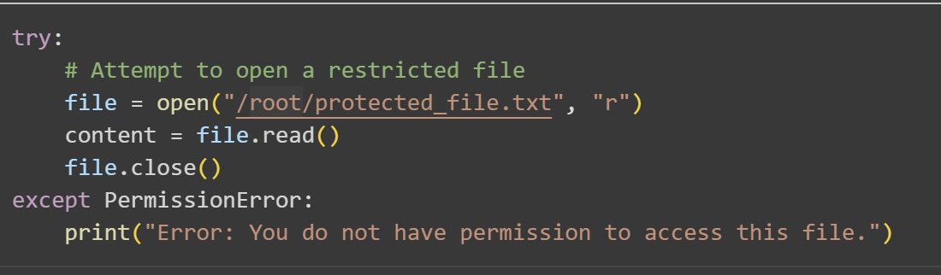
Handling Permission Error for File
Trying to open a file without the necessary permissions raises a PermissionError.
  The try block attempts to open /root/protected_file.txt, which may require administrator privileges.
  If the script lacks the necessary permissions, a PermissionError is raised.
  The except block catches the error and informs the user.

